Slide 1
CS229 Lec 5 Generative Learning algorithms (GDA, Naive Bayes)

Slide 2
For a (binary) Classification problem..
Discriminative Learning Algorithms:
1. Learn decision boundary θᵀx = 0
2. To classify a new data, check on which side of the decision boundary it falls (p(y=1|x) by calculate hθ(x))
Logistic Regression Perceptron
p(y|x; θ) as hθ(x) = g(θᵀx) g(z) = sigmoid = 1 / (1 + exp(-z)) g(z) = step function 1 when >= 0.5, 0 otherwise 1 if z > 0, and 0 otherwise

Slide 3
For a (binary) Classification problem..
Generative Learning Algorithms:
1. Learn p(x|y) (and p(y) - class prior)
2. By Bayesian rule: p(y|x) = p(x|y)p(y) / p(x)
(denominator p(x) can be gone for classification: both p(y=1|x) & p(y=0|x) has it)
GDA Naive Bayes
p(y|x; θ) as hθ(x) = g(θᵀx) g(z) = sigmoid = 1 / (1 + exp(-z)) g(z) = step function 1 when >= 0.5, 0 otherwise 1 if z > 0, and 0 otherwise

Slide 4
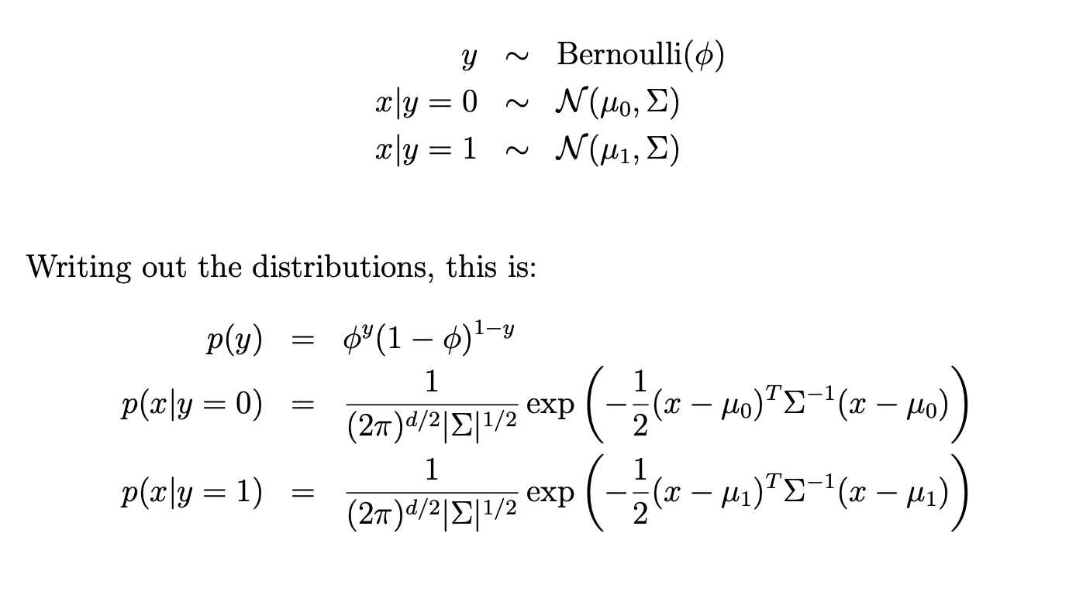
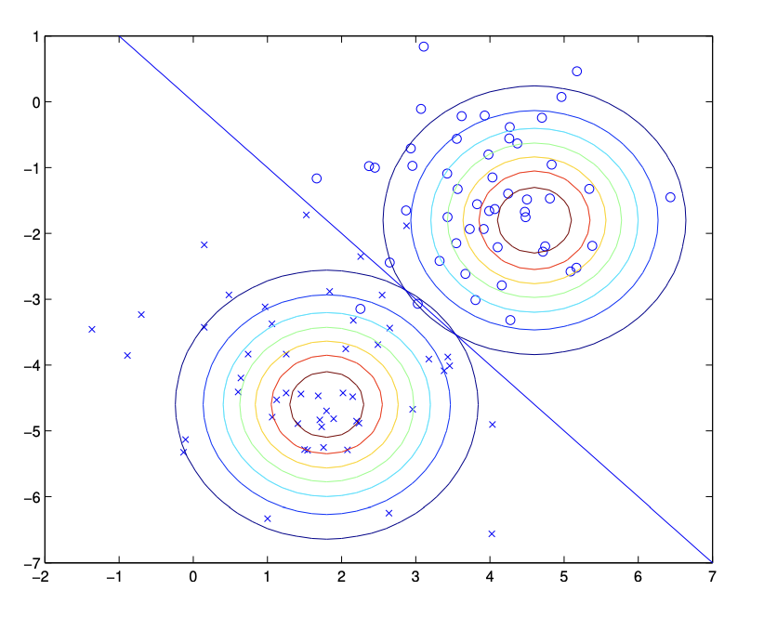
GDA (Gaussian Discriminant Analysis)
When we have a classification problem in which the input features x are continuous-valued random variables, we can then use the Gaussian Discriminant Analysis (GDA) model, which models p(x|y) using a multivariate normal distribution. The model is:

Slide 5
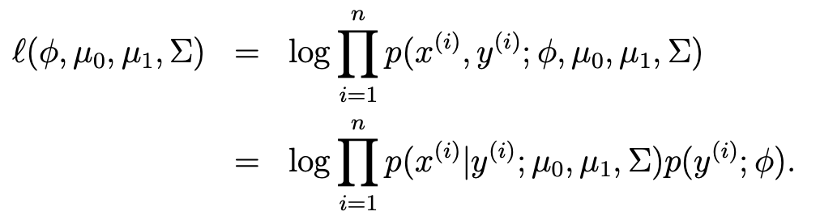
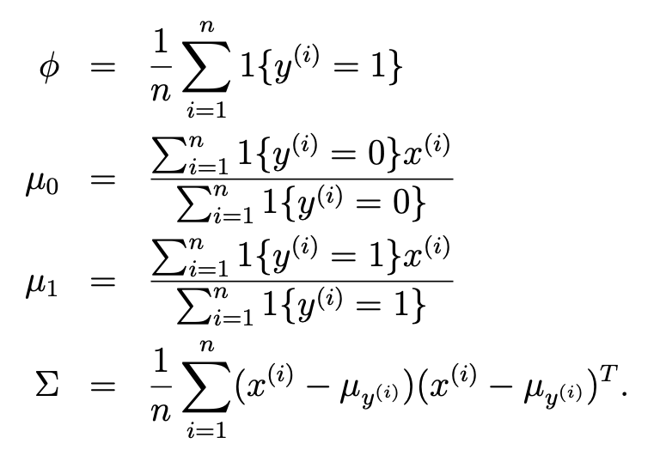
GDA (Gaussian Discriminant Analysis)
To find the model, find the parameters by MLE:
-> Fraction of y=1
-> Sum of the feature vectors where y=0 / The number of examples y=0

Slide 6
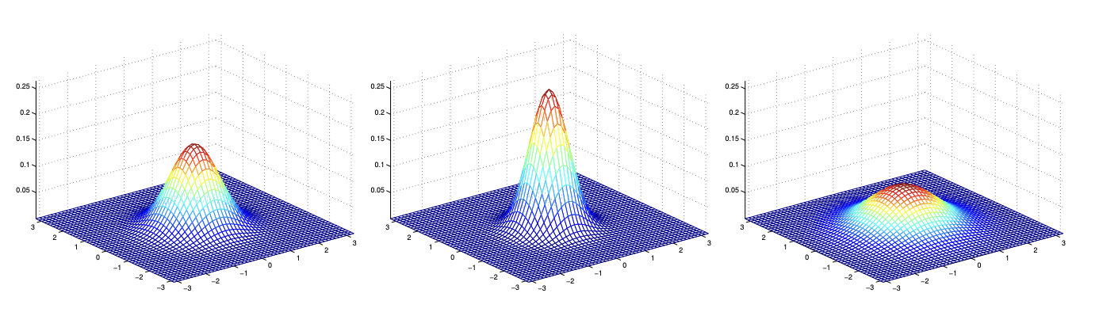
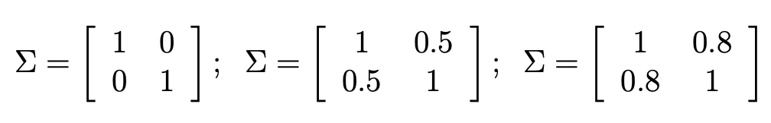
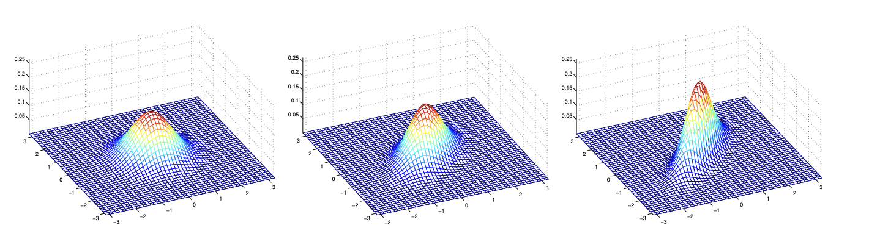
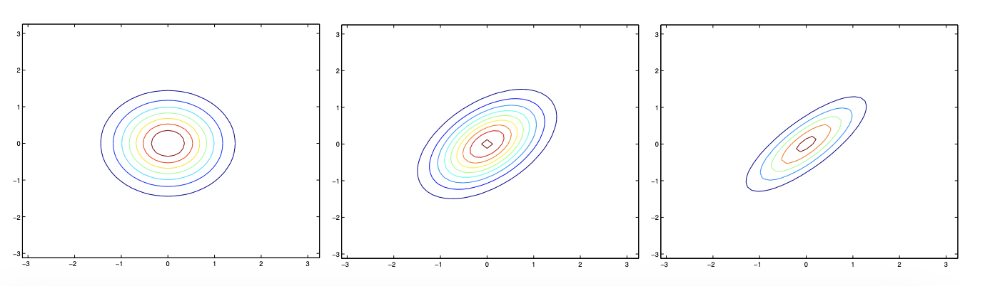
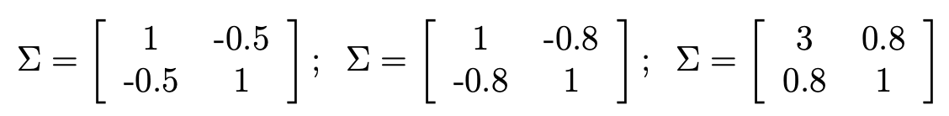
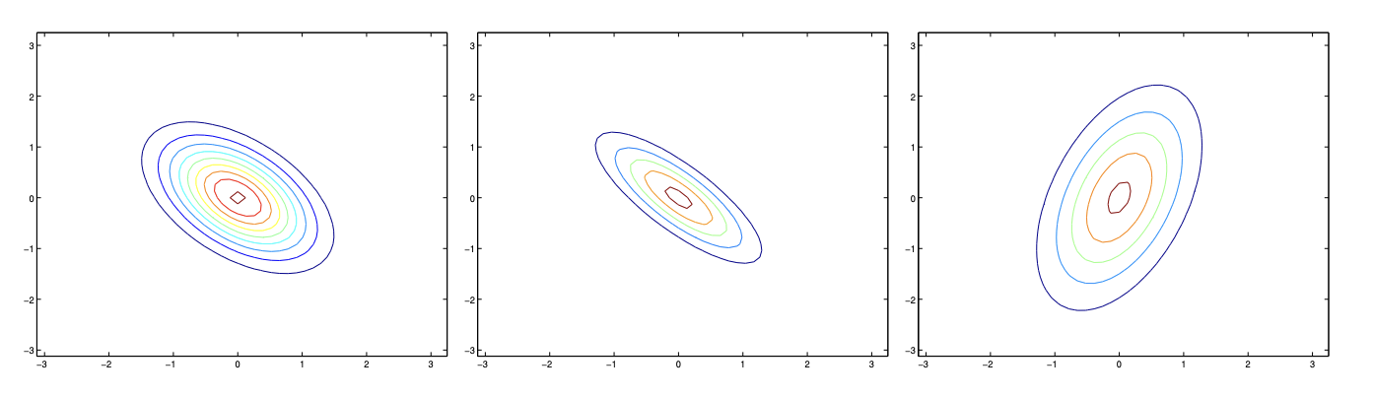
GDA (Gaussian Discriminant Analysis)
covariance:
Off-diagonal entries:

Slide 7
GDA (Gaussian Discriminant Analysis)
1. Assumption: p(x|y=k) is Gaussian (plot your data!)
x|y=k ~ 𝒩(μₖ, Σ) with shared covariance Cov(X) = Σ
2. Learn Parameters:
φ=P(y=1), μ₀, μ₁, Σ — Learn via MLE and Plug into
3. Prediction(Goal):
Using Bayes' Rule,
compute p(y=1∣x) or choose argmax y p(x|y)p(y) (if classification)
Decision boundary:
linear if shared Σ, quadratic otherwise

Slide 8
Comparison between Generative vs. Discriminative approach
GDA (Gaussian Discriminant Analysis) | Logistic Regression
Strong assumption & Less data | More data
Computationally efficient (fast!) | Better performance when Gaussian assumption does not hold

Slide 9
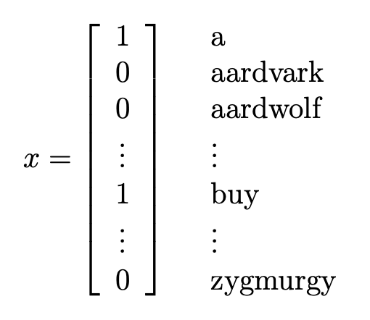
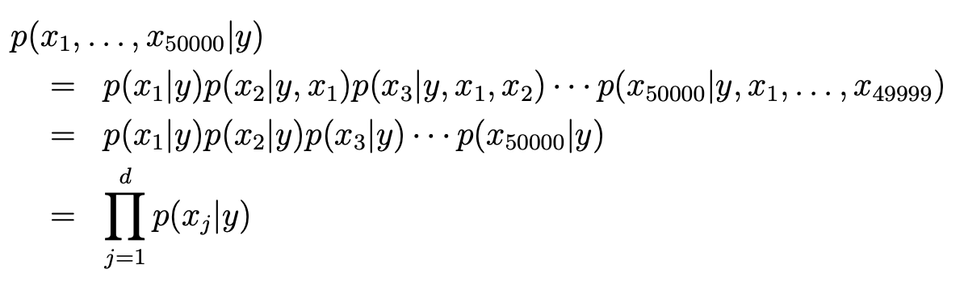
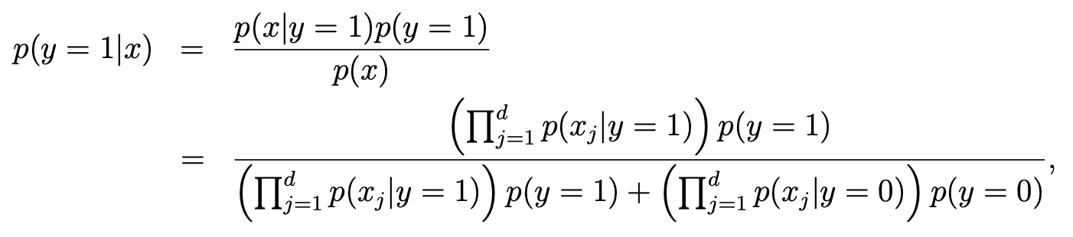
Naive Bayes Classifier
1. Very strong Assumption: (Naive Bayes (NB) assumption)
(1) x ∈ {0, 1}ⁿ
(2) xⱼ ’s are conditionally independent given y.
2. Learn Parameters:
ϕⱼ|y=1 = P(xⱼ = 1 | y = 1)
ϕⱼ|y=0 = P(xⱼ = 1 | y = 0)
ϕᵧ = P(y = 1)
3. Prediction(Goal):
Using Bayes' Rule,
compute p(y=1∣x) or choose argmax y p(x|y)p(y) (if classification)

